Slide 1
Text box
What’s in your tank?
he was.
³⁵ Very early in the morning, while it was still dark, Jesus got up, left the house and went off to a solitary place, where he prayed. Simon and his companions went to look for him, ³⁷ and when they found him, they exclaimed: “Everyone is looking for you!”

Slide 2
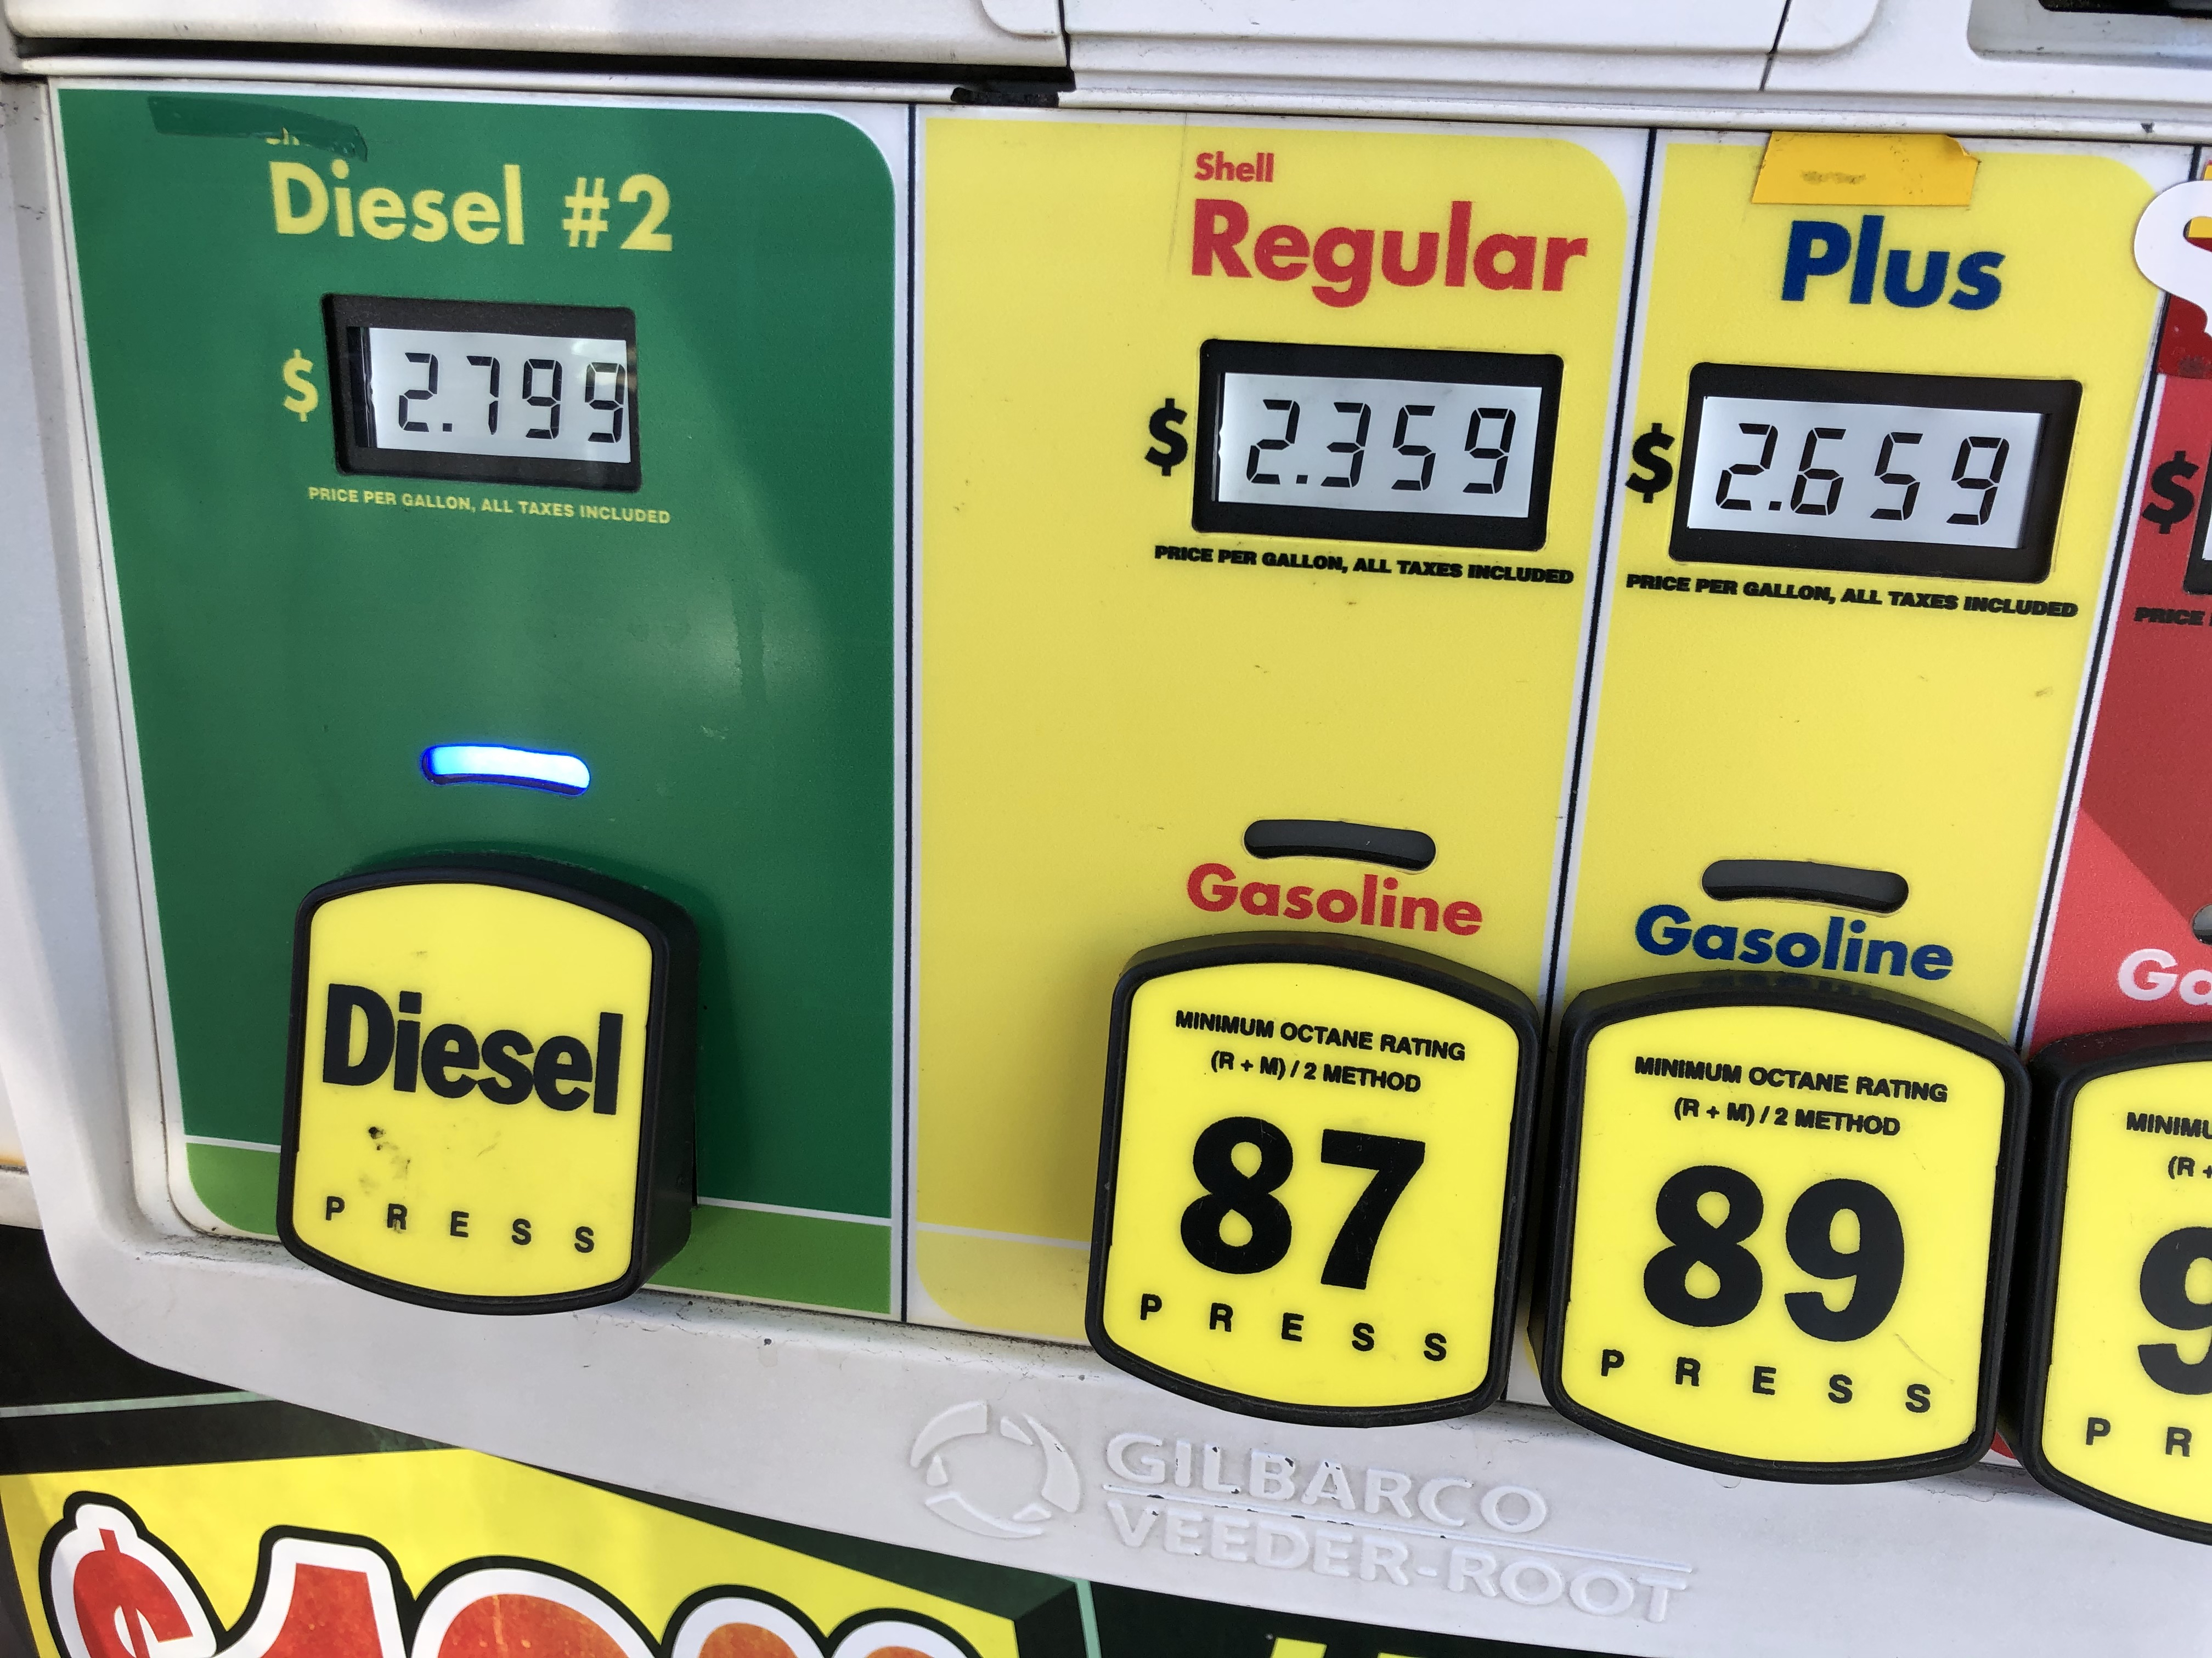
Text box
he was.
³⁵ Very early in the morning, while it was still dark, Jesus got up, left the house and went off to a solitary place, where he prayed. Simon and his companions went to look for him, ³⁷ and when they found him, they exclaimed: “Everyone is looking for you!”

Slide 3
Text box
Popular fuels
1. Self-motivation
2. Adrenaline
3. Caffeine
he was.
³⁵ Very early in the morning, while it was still dark, Jesus got up, left the house and went off to a solitary place, where he prayed. Simon and his companions went to look for him, ³⁷ and when they found him, they exclaimed: “Everyone is looking for you!”

Slide 4
Text box
God fuels
1. Jesus
2. Holy Spirit
3. Joy
he was.
³⁵ Very early in the morning, while it was still dark, Jesus got up, left the house and went off to a solitary place, where he prayed. Simon and his companions went to look for him, ³⁷ and when they found him, they exclaimed: “Everyone is looking for you!”

Slide 5
Text box
2 Corinthians 4:6-7
For God, who said, “Let light shine out of darkness,” made his light shine in our hearts to give us the light of the knowledge of God’s glory displayed in the face of Christ.
⁷ But we have this treasure in jars of clay to show that this all-surpassing power is from God and not from us.
he was.
³⁵ Very early in the morning, while it was still dark, Jesus got up, left the house and went off to a solitary place, where he prayed. Simon and his companions went to look for him, ³⁷ and when they found him, they exclaimed: “Everyone is looking for you!”

Slide 6
Text box
Acts 1:8
You will receive power (fuel) when the Holy Spirit comes upon you (fills you).
And then…
he was.
³⁵ Very early in the morning, while it was still dark, Jesus got up, left the house and went off to a solitary place, where he prayed. Simon and his companions went to look for him, ³⁷ and when they found him, they exclaimed: “Everyone is looking for you!”

Slide 7
Text box
Question:
What’s in your tank?
he was.
³⁵ Very early in the morning, while it was still dark, Jesus got up, left the house and went off to a solitary place, where he prayed. Simon and his companions went to look for him, ³⁷ and when they found him, they exclaimed: “Everyone is looking for you!”

Slide 8
Text box
he was.
³⁵ Very early in the morning, while it was still dark, Jesus got up, left the house and went off to a solitary place, where he prayed. Simon and his companions went to look for him, ³⁷ and when they found him, they exclaimed: “Everyone is looking for you!”

Slide 9
Text box
God fuels
1. Jesus
2. Holy Spirit
3. Joy
he was.
³⁵ Very early in the morning, while it was still dark, Jesus got up, left the house and went off to a solitary place, where he prayed. Simon and his companions went to look for him, ³⁷ and when they found him, they exclaimed: “Everyone is looking for you!”

