Slide 1
Text box
Traffic Lights
he was.
³⁵ Very early in the morning, while it was still dark, Jesus got up, left the house and went off to a solitary place, where he prayed. Simon and his companions went to look for him, ³⁷ and when they found him, they exclaimed: “Everyone is looking for you!”

Slide 2
Text box
he was.
³⁵ Very early in the morning, while it was still dark, Jesus got up, left the house and went off to a solitary place, where he prayed. Simon and his companions went to look for him, ³⁷ and when they found him, they exclaimed: “Everyone is looking for you!”

Slide 3
Text box
he was.
³⁵ Very early in the morning, while it was still dark, Jesus got up, left the house and went off to a solitary place, where he prayed. Simon and his companions went to look for him, ³⁷ and when they found him, they exclaimed: “Everyone is looking for you!”

Slide 4
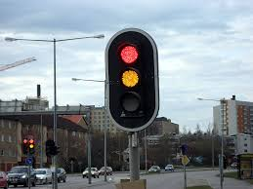
Text box
he was.
³⁵ Very early in the morning, while it was still dark, Jesus got up, left the house and went off to a solitary place, where he prayed. Simon and his companions went to look for him, ³⁷ and when they found him, they exclaimed: “Everyone is looking for you!”

Slide 5
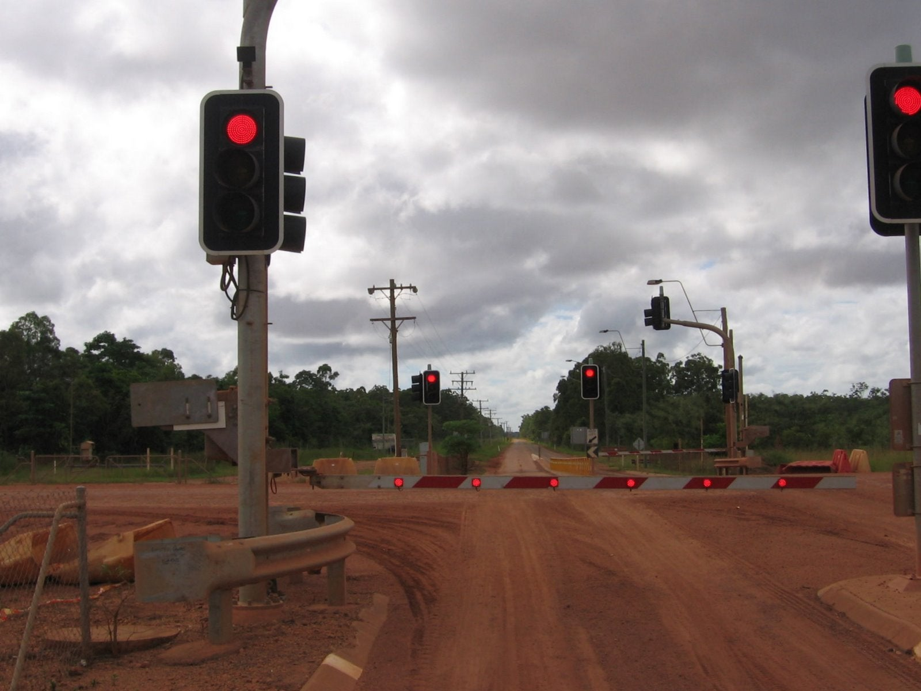
Text box
he was.
³⁵ Very early in the morning, while it was still dark, Jesus got up, left the house and went off to a solitary place, where he prayed. Simon and his companions went to look for him, ³⁷ and when they found him, they exclaimed: “Everyone is looking for you!”

Slide 6
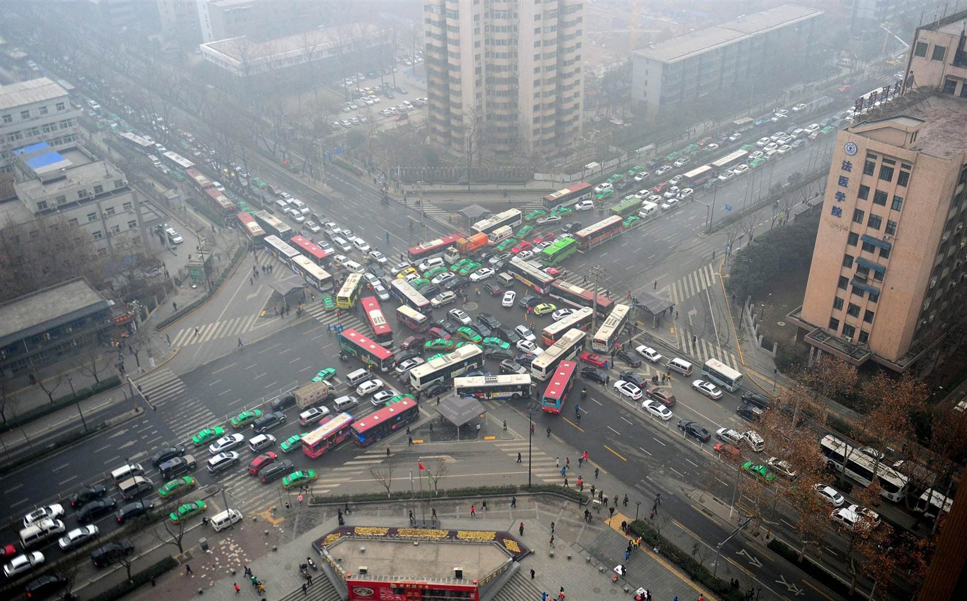
Text box
he was.
³⁵ Very early in the morning, while it was still dark, Jesus got up, left the house and went off to a solitary place, where he prayed. Simon and his companions went to look for him, ³⁷ and when they found him, they exclaimed: “Everyone is looking for you!”

Slide 7
Text box
Traffic Lights
he was.
³⁵ Very early in the morning, while it was still dark, Jesus got up, left the house and went off to a solitary place, where he prayed. Simon and his companions went to look for him, ³⁷ and when they found him, they exclaimed: “Everyone is looking for you!”

Slide 8
Text box
Exodus 14:1-15
Then the Lord said to Moses, ² “Tell the Israelites to turn back and encamp near Pi Hahiroth, between Migdol and the sea.
he was.
³⁵ Very early in the morning, while it was still dark, Jesus got up, left the house and went off to a solitary place, where he prayed. Simon and his companions went to look for him, ³⁷ and when they found him, they exclaimed: “Everyone is looking for you!”

Slide 9
Text box
Exodus 14:1-15
They are to encamp by the sea, directly opposite Baal Zephon. ³ Pharaoh will think, ‘The Israelites are wandering around the land in confusion, hemmed in by the desert.’
he was.
³⁵ Very early in the morning, while it was still dark, Jesus got up, left the house and went off to a solitary place, where he prayed. Simon and his companions went to look for him, ³⁷ and when they found him, they exclaimed: “Everyone is looking for you!”

Slide 10
Text box
Exodus 14:1-15
⁴ And I will harden Pharaoh’s heart, and he will pursue them. But I will gain glory for myself through Pharaoh and all his army, and the Egyptians will know that I am the Lord.” So the Israelites did this.
he was.
³⁵ Very early in the morning, while it was still dark, Jesus got up, left the house and went off to a solitary place, where he prayed. Simon and his companions went to look for him, ³⁷ and when they found him, they exclaimed: “Everyone is looking for you!”

Slide 11
Text box
Exodus 14:1-15
⁵ When the king of Egypt was told that the people had fled, Pharaoh and his officials changed their minds about them and said, “What have we done? We have let the Israelites go and have lost their services!”
he was.
³⁵ Very early in the morning, while it was still dark, Jesus got up, left the house and went off to a solitary place, where he prayed. Simon and his companions went to look for him, ³⁷ and when they found him, they exclaimed: “Everyone is looking for you!”

Slide 12
Text box
Exodus 14:1-15
⁶ So he had his chariot made ready and took his army with him. ⁷ He took six hundred of the best chariots, along with all the other chariots of Egypt, with officers over all of them.
he was.
³⁵ Very early in the morning, while it was still dark, Jesus got up, left the house and went off to a solitary place, where he prayed. Simon and his companions went to look for him, ³⁷ and when they found him, they exclaimed: “Everyone is looking for you!”

Slide 13
Text box
Exodus 14:1-15
⁸ The Lord hardened the heart of Pharaoh king of Egypt, so that he pursued the Israelites, who were marching out boldly.
he was.
³⁵ Very early in the morning, while it was still dark, Jesus got up, left the house and went off to a solitary place, where he prayed. Simon and his companions went to look for him, ³⁷ and when they found him, they exclaimed: “Everyone is looking for you!”

Slide 14
Text box
Exodus 14:1-15
⁹ The Egyptians—all Pharaoh’s horses and chariots, horsemen and troops—pursued the Israelites and overtook them as they camped by the sea near Pi Hahiroth, opposite Baal Zephon.
he was.
³⁵ Very early in the morning, while it was still dark, Jesus got up, left the house and went off to a solitary place, where he prayed. Simon and his companions went to look for him, ³⁷ and when they found him, they exclaimed: “Everyone is looking for you!”

Slide 15
Text box
Exodus 14:1-15
¹⁰ As Pharaoh approached, the Israelites looked up, and there were the Egyptians, marching after them. They were terrified and cried out to the Lord.
he was.
³⁵ Very early in the morning, while it was still dark, Jesus got up, left the house and went off to a solitary place, where he prayed. Simon and his companions went to look for him, ³⁷ and when they found him, they exclaimed: “Everyone is looking for you!”

Slide 16
Text box
Exodus 14:1-15
¹¹ They said to Moses, “Was it because there were no graves in Egypt that you brought us to the desert to die? What have you done to us by bringing us out of Egypt?
he was.
³⁵ Very early in the morning, while it was still dark, Jesus got up, left the house and went off to a solitary place, where he prayed. Simon and his companions went to look for him, ³⁷ and when they found him, they exclaimed: “Everyone is looking for you!”

Slide 17
Text box
Exodus 14:1-15
¹² Didn’t we say to you in Egypt, ‘Leave us alone; let us serve the Egyptians’? It would have been better for us to serve the Egyptians than to die in the desert!”
he was.
³⁵ Very early in the morning, while it was still dark, Jesus got up, left the house and went off to a solitary place, where he prayed. Simon and his companions went to look for him, ³⁷ and when they found him, they exclaimed: “Everyone is looking for you!”

Slide 18
Text box
Exodus 14:1-15
¹³ Moses answered the people, “Do not be afraid. Stand firm and you will see the deliverance the Lord will bring you today. The Egyptians you see today you will never see again.
he was.
³⁵ Very early in the morning, while it was still dark, Jesus got up, left the house and went off to a solitary place, where he prayed. Simon and his companions went to look for him, ³⁷ and when they found him, they exclaimed: “Everyone is looking for you!”

Slide 19
Text box
Exodus 14:1-15
¹⁴ The Lord will fight for you; you need only to be still.”
¹⁵ Then the Lord said to Moses, “Why are you crying out to me? Tell the Israelites to move on.
he was.
³⁵ Very early in the morning, while it was still dark, Jesus got up, left the house and went off to a solitary place, where he prayed. Simon and his companions went to look for him, ³⁷ and when they found him, they exclaimed: “Everyone is looking for you!”

Slide 20
Text box
Exodus 14:1-15
¹⁴ The Lord will fight for you; you need only to be still.”
¹⁵ Then the Lord said to Moses, “Why are you crying out to me? Tell the Israelites to move on.
he was.
³⁵ Very early in the morning, while it was still dark, Jesus got up, left the house and went off to a solitary place, where he prayed. Simon and his companions went to look for him, ³⁷ and when they found him, they exclaimed: “Everyone is looking for you!”

Slide 21
Text box
he was.
³⁵ Very early in the morning, while it was still dark, Jesus got up, left the house and went off to a solitary place, where he prayed. Simon and his companions went to look for him, ³⁷ and when they found him, they exclaimed: “Everyone is looking for you!”

