Slide 1
Encouraging One Another November 25, 2018

Slide 2
From the overflow of the heart, the mouth speaks
Never say “Shame on you”
Avoid negative defining labels
Say “I’m sorry”

Slide 3
For out of the abundance of the heart the mouth
speaks. Matthew 12:34
Keep your heart with all vigilance, for from it flow the
springs of life. Proverbs 4:23
The good person out of the good treasure of the
heart produces good, and the evil person out of evil
treasure produces evil; for it is out of the abundance
of the heart that the mouth speaks. Luke 6:45

Slide 4
Mediatate on God’s Truth
Surround yourself with positive people
Be intentional in your encouragement

Slide 5
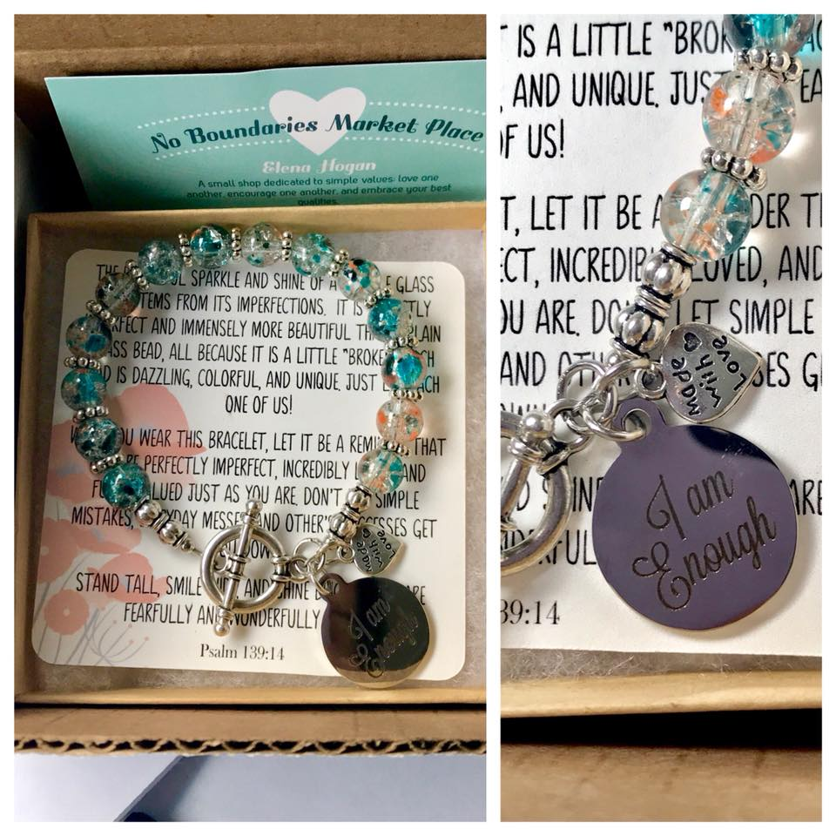
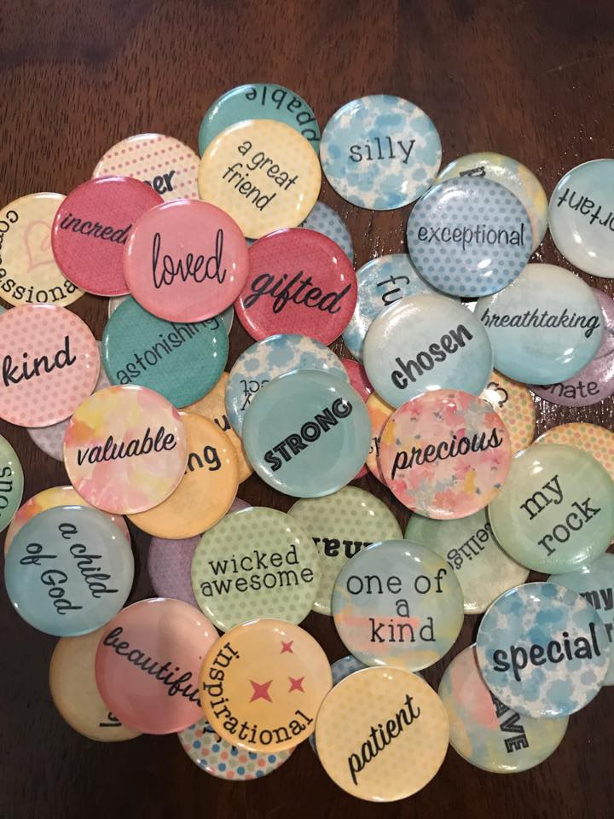

Slide 6
From the overflow of the heart, the mouth speaks

Slide 7
And let us consider how we may spur one another on toward love and good deeds,
not giving up meeting together, as some are in the habit of doing, but encouraging one another—and all the more as you see the Day approaching.
Hebrews 10:24-25

