Slide 1
Text box
What do you do after the Angels have gone?
he was.
³⁵ Very early in the morning, while it was still dark, Jesus got up, left the house and went off to a solitary place, where he prayed. Simon and his companions went to look for him, ³⁷ and when they found him, they exclaimed: “Everyone is looking for you!”

Slide 2
Text box
Luke 2:8-18
And there were shepherds living out in the fields nearby, keeping watch over their flocks at night. ⁹ An angel of the Lord appeared to them, and the glory of the Lord shone around them, and they were terrified.
he was.
³⁵ Very early in the morning, while it was still dark, Jesus got up, left the house and went off to a solitary place, where he prayed. Simon and his companions went to look for him, ³⁷ and when they found him, they exclaimed: “Everyone is looking for you!”

Slide 3
Text box
Luke 2:8-18
¹⁰ But the angel said to them, “Do not be afraid. I bring you good news that will cause great joy for all the people. ¹¹ Today in the town of David a Savior has been born to you; he is the Messiah, the Lord.
he was.
³⁵ Very early in the morning, while it was still dark, Jesus got up, left the house and went off to a solitary place, where he prayed. Simon and his companions went to look for him, ³⁷ and when they found him, they exclaimed: “Everyone is looking for you!”

Slide 4
Text box
Luke 2:8-18
¹² This will be a sign to you: You will find a baby wrapped in cloths and lying in a manger.”
¹³ Suddenly a great company of the heavenly host appeared with the angel, praising God and saying,
he was.
³⁵ Very early in the morning, while it was still dark, Jesus got up, left the house and went off to a solitary place, where he prayed. Simon and his companions went to look for him, ³⁷ and when they found him, they exclaimed: “Everyone is looking for you!”

Slide 5
Text box
Luke 2:8-18
¹⁴ “Glory to God in the highest heaven, and on earth peace to those on whom his favor rests.”
he was.
³⁵ Very early in the morning, while it was still dark, Jesus got up, left the house and went off to a solitary place, where he prayed. Simon and his companions went to look for him, ³⁷ and when they found him, they exclaimed: “Everyone is looking for you!”

Slide 6
Text box
Luke 2:8-18
¹⁵ When the angels had gone into heaven, the shepherds said to one another, “Let’s go to Bethlehem and see this thing that has happened, which the Lord has told us about.”
he was.
³⁵ Very early in the morning, while it was still dark, Jesus got up, left the house and went off to a solitary place, where he prayed. Simon and his companions went to look for him, ³⁷ and when they found him, they exclaimed: “Everyone is looking for you!”

Slide 7
Text box
Luke 2:8-18
¹⁶ So they hurried off and found Mary and Joseph, and the baby, who was lying in the manger.
he was.
³⁵ Very early in the morning, while it was still dark, Jesus got up, left the house and went off to a solitary place, where he prayed. Simon and his companions went to look for him, ³⁷ and when they found him, they exclaimed: “Everyone is looking for you!”

Slide 8
Text box
Luke 2:8-18
¹⁷ When they had seen him, they spread the word concerning what had been told them about this child, ¹⁸ and all who heard it were amazed at what the shepherds said to them.
he was.
³⁵ Very early in the morning, while it was still dark, Jesus got up, left the house and went off to a solitary place, where he prayed. Simon and his companions went to look for him, ³⁷ and when they found him, they exclaimed: “Everyone is looking for you!”

Slide 9
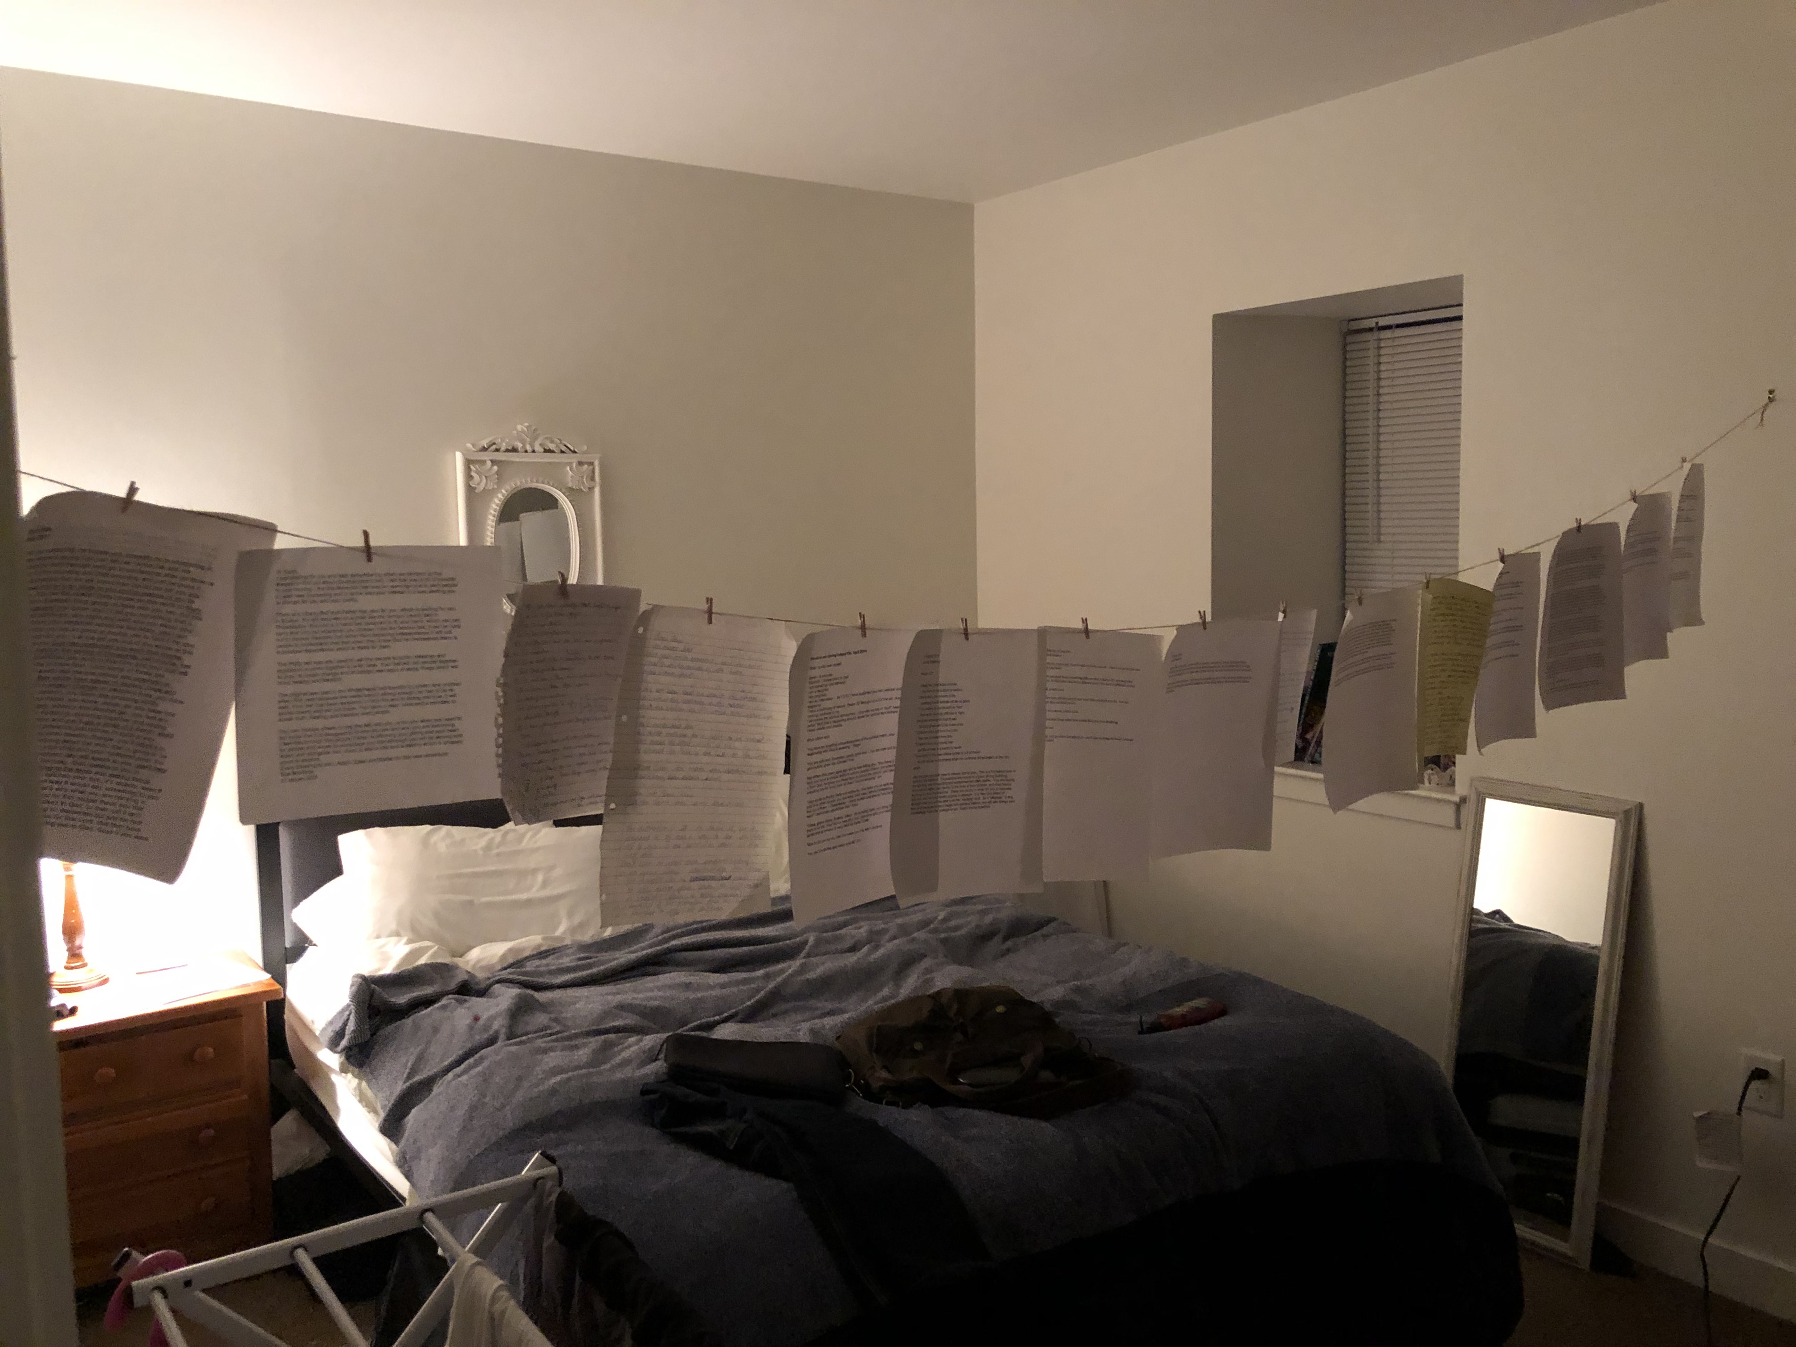
Text box
he was.
³⁵ Very early in the morning, while it was still dark, Jesus got up, left the house and went off to a solitary place, where he prayed. Simon and his companions went to look for him, ³⁷ and when they found him, they exclaimed: “Everyone is looking for you!”

Slide 10
Text box
Deuteronomy 6:7-10
⁷ Impress them on your children. Talk about them when you sit at home and when you walk along the road, when you lie down and when you get up.
he was.
³⁵ Very early in the morning, while it was still dark, Jesus got up, left the house and went off to a solitary place, where he prayed. Simon and his companions went to look for him, ³⁷ and when they found him, they exclaimed: “Everyone is looking for you!”

Slide 11
Text box
Deuteronomy 6:7-10
⁸ Tie them as symbols on your hands and bind them on your foreheads. ⁹ Write them on the doorframes of your houses and on your gates.
he was.
³⁵ Very early in the morning, while it was still dark, Jesus got up, left the house and went off to a solitary place, where he prayed. Simon and his companions went to look for him, ³⁷ and when they found him, they exclaimed: “Everyone is looking for you!”

Slide 12
Text box
Deuteronomy 4:9
⁹ Only be careful, and watch yourselves closely so that you do not forget the things your eyes have seen or let them fade from your heart as long as you live. Teach them to your children and to their children after them.
he was.
³⁵ Very early in the morning, while it was still dark, Jesus got up, left the house and went off to a solitary place, where he prayed. Simon and his companions went to look for him, ³⁷ and when they found him, they exclaimed: “Everyone is looking for you!”

Slide 13
Text box
May we learn from these simple shepherds.
When we find ourselves feeling like we’re standing in a field, staring into the dark…
he was.
³⁵ Very early in the morning, while it was still dark, Jesus got up, left the house and went off to a solitary place, where he prayed. Simon and his companions went to look for him, ³⁷ and when they found him, they exclaimed: “Everyone is looking for you!”

Slide 14
Text box
May we act.
May we move.
May we seek.
After angels have gone
he was.
³⁵ Very early in the morning, while it was still dark, Jesus got up, left the house and went off to a solitary place, where he prayed. Simon and his companions went to look for him, ³⁷ and when they found him, they exclaimed: “Everyone is looking for you!”

