Slide 1


Slide 2
“Life and Death in Grace”
Genesis 47:28-48:22

Slide 3


Slide 4
"By faith Jacob, when he was dying, blessed each of Joseph's sons, and worshiped as he leaned on the top of his staff.”
Hebrews 11:21

Slide 5


Slide 6
Jacob lived in Egypt seventeen years, and the years of his life were a hundred and forty-seven. When the time drew near for Israel to die, he called for his son Joseph and said to him, “If I have found favor in your eyes, put your hand under my thigh and promise that you will show me kindness and faithfulness. Do not bury me in Egypt, but when I rest with my fathers, carry me out of Egypt and bury me where they are buried.”
“I will do as you say,” he said.
“Swear to me,” he said. Then Joseph swore to him, and Israel worshiped as he leaned on the top of his staff.
Genesis 47:28-31

Slide 7


Slide 8
“It used to be that the Victorians of the 19th Century talked incessantly about death but were silent about sex, whereas today we talk incessantly about sex and are silent about death.”
Richard John Neuhaus

Slide 9


Slide 10
“Regarding readiness to die is the first step in learning to live.”
JI Packer

Slide 12
1. Reject the denial of death held by our contemporary western culture.

Slide 13
1. Reject the denial of death held by our contemporary western culture.
2. Acknowledge that following Jesus Christ involves the idea duel citizenship

Slide 14
1. Reject the denial of death held by our contemporary western culture.
2. Acknowledge that following Jesus Christ involves the idea duel citizenship
3. We can “number our days” “So, teach us to number our days,
that we may gain a heart of wisdom.” Psalm 90:12

Slide 15
1. Reject the denial of death held by our contemporary western culture.
2. Acknowledge that following Jesus Christ involves the idea duel citizenship
3. We can “number our days” “So, teach us to number our days,
that we may gain a heart of wisdom.” Psalm 90:12
4. Practice progressive relinquishment.

Slide 16


Slide 17
Jacob said to Joseph, "God Almighty appeared to me at Luz in the land of Canaan, and there he blessed me and said to me, 'I am going to make you fruitful and will increase your numbers. I will make you a community of peoples, and I will give this land as an everlasting possession to your descendants after you.’
Genesis 48:3-4

Slide 19
“And Joseph took both of them, Ephraim on his right toward Israel's left hand and Manasseh on his left toward Israel's right hand, and brought them close to him. But Israel reached out his right hand and put it on Ephraim's head, though he was the younger, and crossing his arms, he put his left hand on Manasseh's head, even though Manasseh was the firstborn.
Genesis 48: 13-14

Slide 20

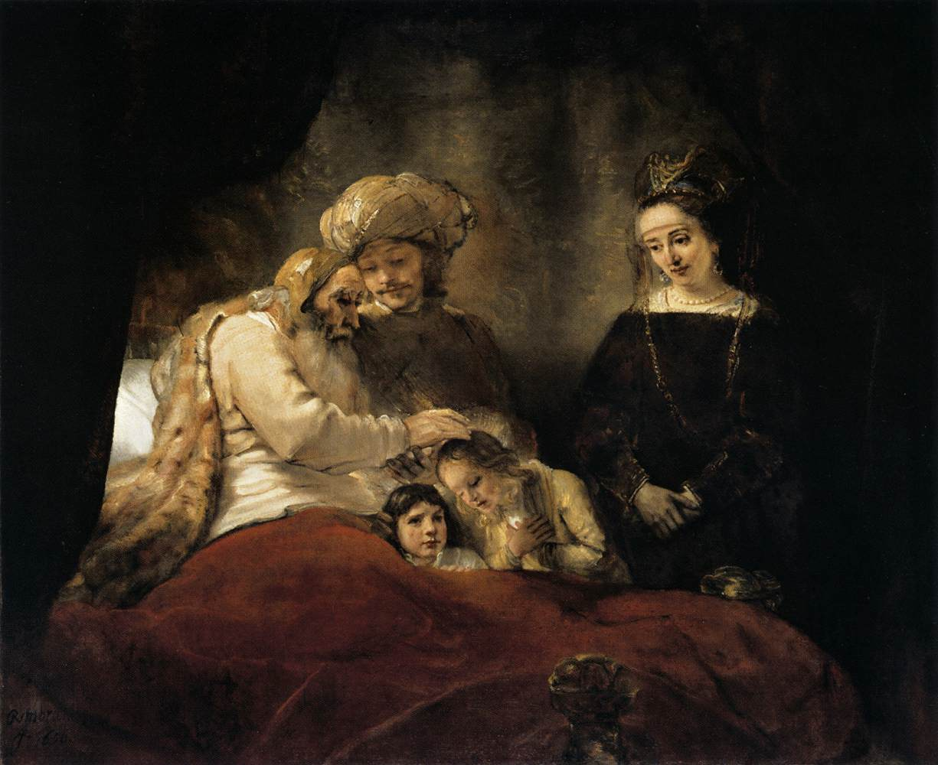
“Jacob Blesses Joseph’s Sons” by
Rembrandt
(1606-1669)

Slide 21
“Christ arrives right on time to make this happen. He didn't, and doesn't, wait for us to get ready. He presented himself for this sacrificial death when we were far too weak and rebellious to do anything to get ourselves ready. And even if we hadn't been so weak, we wouldn't have known what to do anyway.”
Romans 5:6 (The Message)

Slide 22


