Slide 1
FAITH TRIP
JOSHUA 1-6
MATTHEW 10

Slide 2
Wait, you want me to do what?

Slide 3
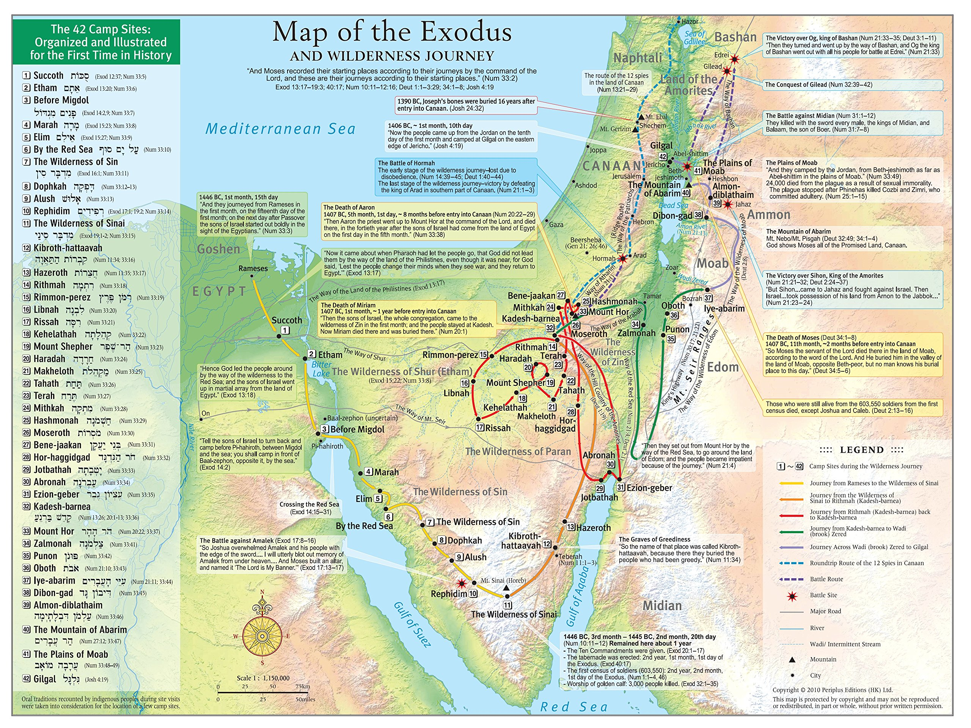

Slide 4
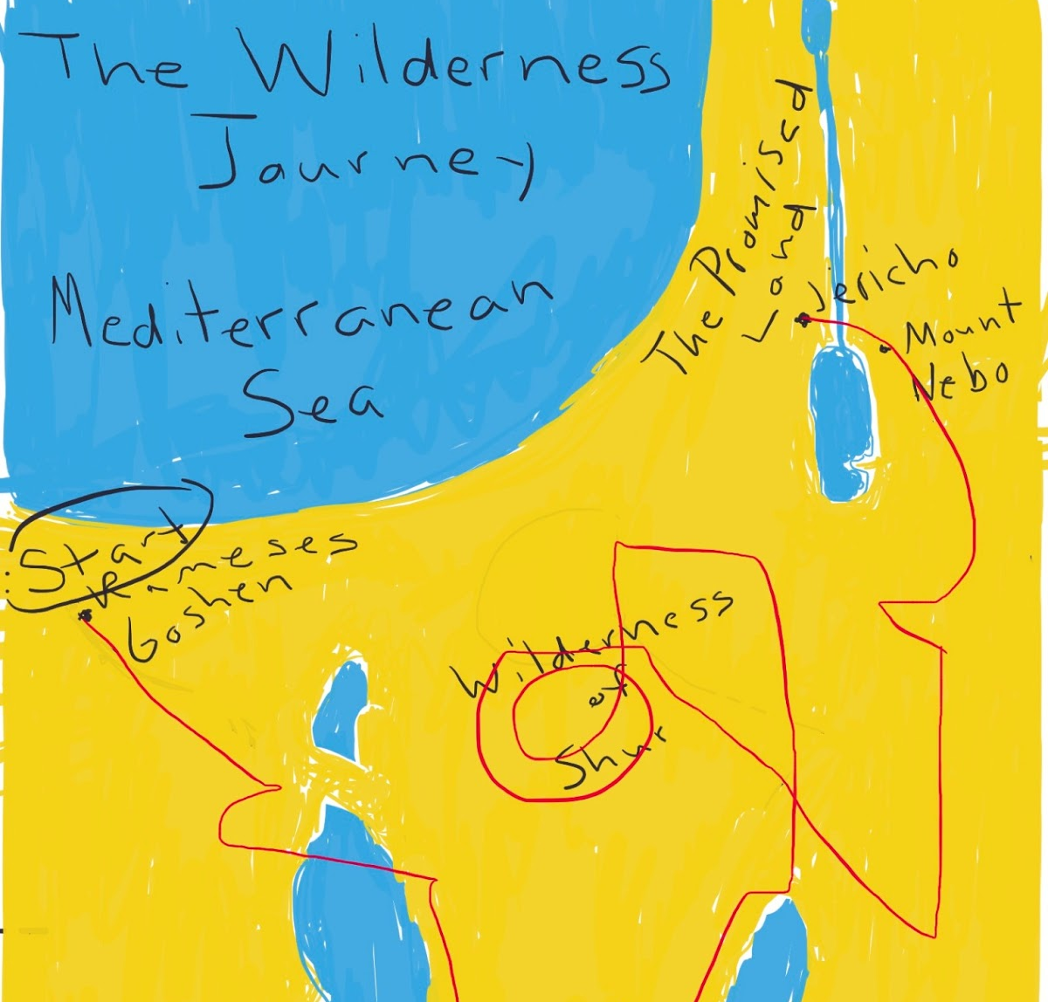

Slide 5
It’s a process, but you’re never alone

Slide 6
JOSHUA 1:1-6
5 No one will be able to stand against you as long as you live. For I will be with you as I was with Moses. I will not fail you or abandon you. 6 “Be strong and courageous, for you are the one who will lead these people to possess all the land I swore to their ancestors I would give them.

Slide 7
It’s a process, but you’re never alone
When He calls you, it may confound you

Slide 8
JOSHUA 6:1-5 NLT
1 Now the gates of Jericho were tightly shut because the people were afraid of the Israelites. No one was allowed to go out or in. 2 But the LORD said to Joshua, “I have given you Jericho, its king, and all its strong warriors.

Slide 9
JOSHUA 6:1-5
3 You and your fighting men should march around the town once a day for six days. 4 Seven priests will walk ahead of the Ark, each carrying a ram’s horn. On the seventh day you are to march around the town seven times, with the priests blowing the horns.

Slide 10
JOSHUA 6:1-5
5 When you hear the priests give one long blast on the rams’ horns, have all the people shout as loud as they can. Then the walls of the town will collapse, and the people can charge straight into the town.”

Slide 12
It’s a process, but you’re never alone
When He calls you, it may confound you
Saying yes in the impossible invites the miraculous

Slide 13
MATTHEW 10:7-8 NLT
7 Go and announce to them that the Kingdom of Heaven is near. 8 Heal the sick, raise the dead, cure those with leprosy, and cast out demons. Give as freely as you have received!

